Slide 1
Mass Case Tester (Haley/Oracle)
Mass Case Tester (MCT) evaluates the effectiveness of rules that prove particular goals
Can identify
  Longest path to a goal outcome (greatest number of questions asked)
  Shortest path to a goal outcome
  Attributes that are meant to be mutually exclusive but actually overlap
  Intermediate attributes that always evaluate to a particular value (universal truths)
  Other unexpected outcomes

Slide 2
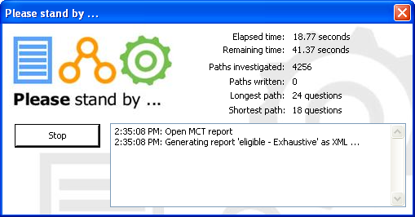
Mass Case Tester...

Slide 3
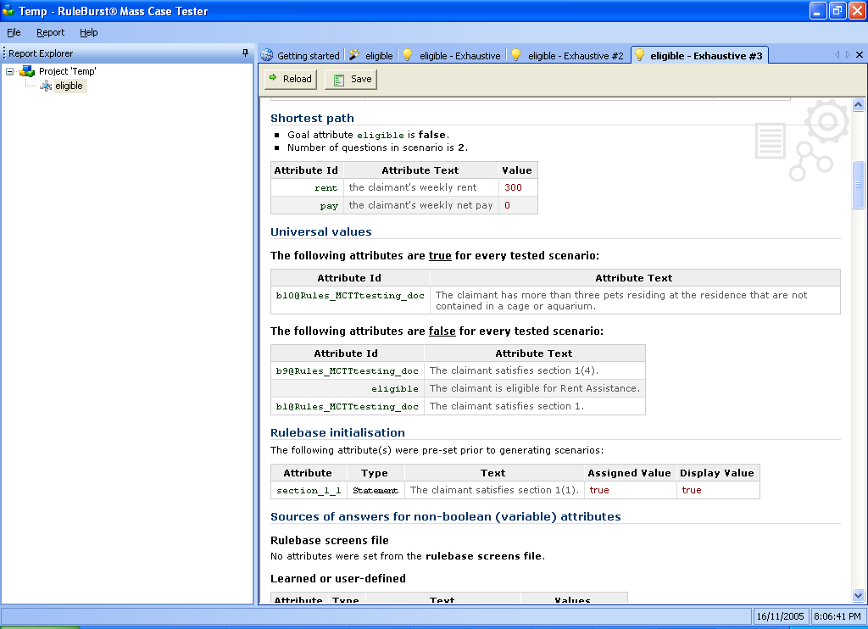
Mass Case Tester...

Slide 4
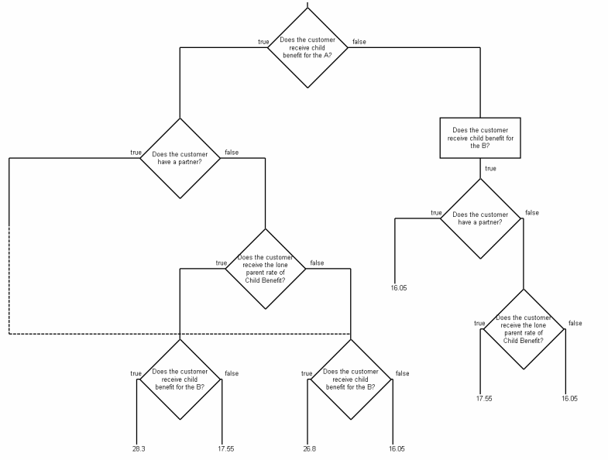
Mass Case Tester...

Slide 5

NICTA Approach
  Phase 1: Constraint programming
    Encode rule base and queries as constraints
    Use a constraint solver to generate test cases quickly
  Phase 2: Theorem proving
    Encode rule base, queries and test cases in logic
    Analyse for minimality, explain inconsistencies, dependencies, tautologies

Slide 6
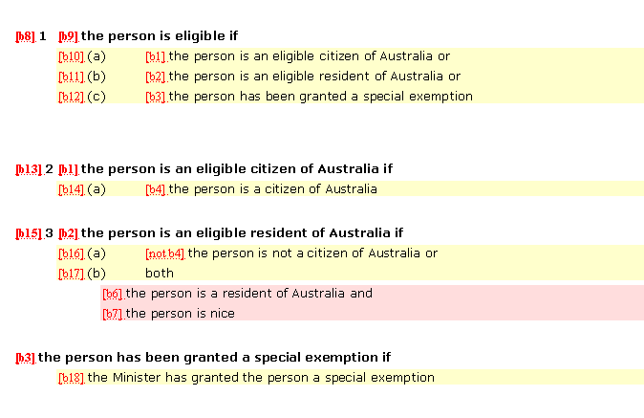
Business Rules

Slide 7
Logical Analysis
b9 is true if
b4 or not b4 !

Slide 8
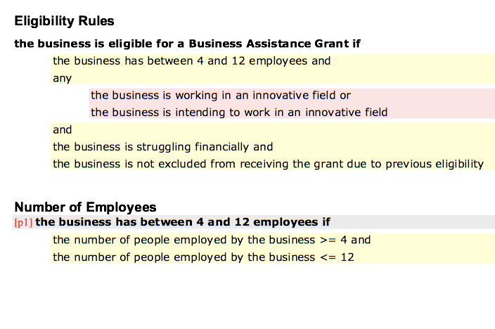
Rules

Slide 9

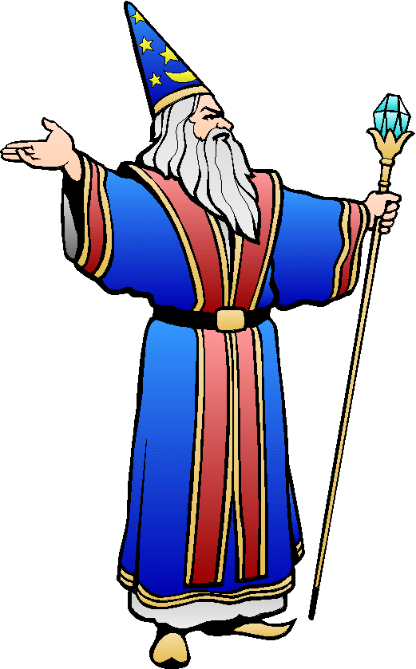
Inconsistencies
Am I Eligible?
4 ≤ Nr employees ≤ 12 ?
Expenses > Income ?
Can't both be true
at the same time
...
Nr employees ≤ 3 ?
Can't reach conclusion: there is no "test case" for the underlying rule applications
Why bother asking these questions?

Slide 10
Functional Dependencies
Am I Eligible?
4 ≤ Nr employees ≤ 12 ?
Expenses > Income ?
Entails
...
Nr employees ≤ 100 ?
Don't need to ask "Nr employees ≤ 100 ? "
Test case contains redundancy
Why bother asking these questions?

Slide 11
Tautologies
Am I Eligible?
4 ≤ Nr employees ≤ 12 ?
( Expenses > Income ?
Either one must be true
...
or Expenses ≤ Income ? )
Conclusion follows from "4 ≤ Nr employees ≤ 12 " alone
Why bother asking the other questions?

